Slide 1
The Shape of Messages to Come: Messages for the Long Now
EDC&I 583
Message Design
29 February 02012

Slide 2
This Evening’s Agenda
Good and bad examples
Other examples
Presentation on the Future of Message Design
Project check-in
Designing our final class session
Course evaluation

Slide 3
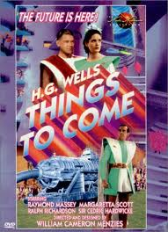
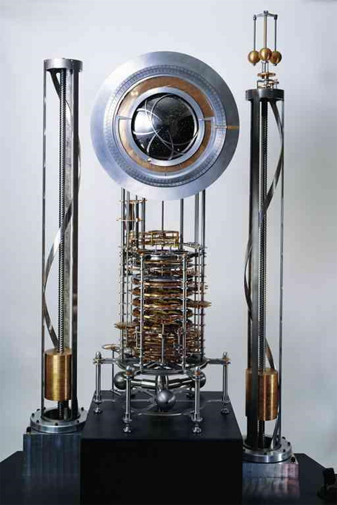
(Where Does He Get Those Weird Titles…?!)
1936 British Sci FI flic
Clock of the Long Now

Slide 4
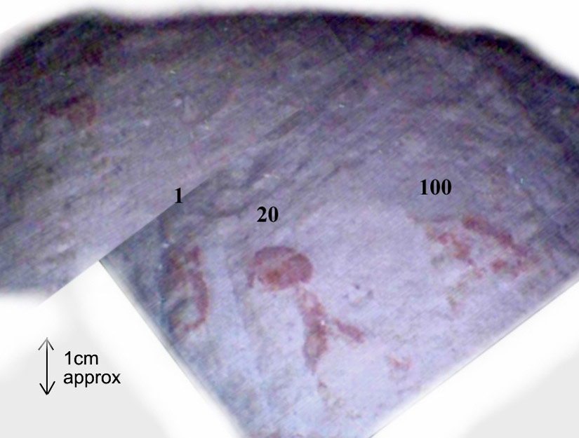
Communicating to the Future: A Chancy Business
Inside the Great Pyramid – mysterious double doors, secret chambers
What did those red-painted signs on the floor mean?
“Why is there writing in this space? What does the writing say?”
Conclusion: Probably engineers’ notations
Stay tuned! “Last secret door of Great Pyramid 'to be opened in 2012,” says British company

Slide 5
But There’s a Serious Purpose in Terms of Message Design
Problem: How do you communicate to a population many generations (400!) in the future
Language?
Customs?
Understanding of our contemporary warning symbols?

Slide 6
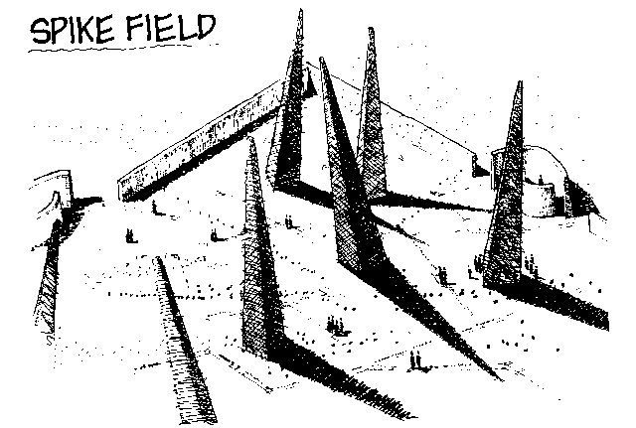
Other options…
Form of the earth itself
forbidding, frightening
a universal message of “Stay away!”

Slide 7
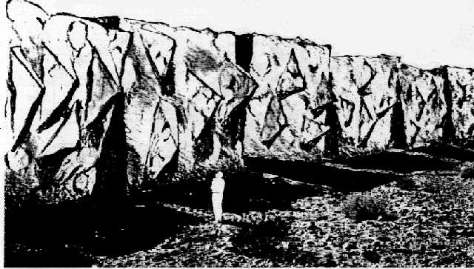
Would People Pay Attention?
Probably
But would they stay away?
Just ask any group of 14-year old kids with time on their hands…

Slide 8
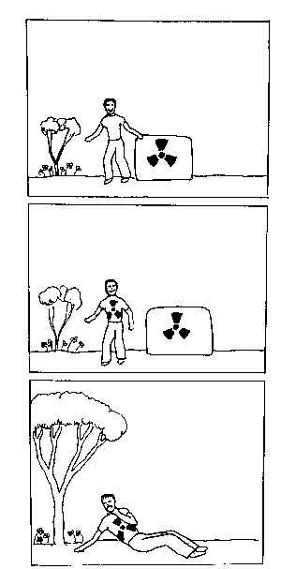
Communicating the “Fear Message”
“This place will make you sick; stay away!”

Slide 9
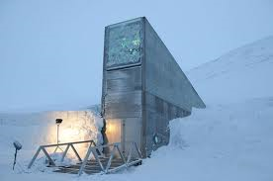
Positive Messages for the Future
Svalbard Global Seed Vault (assuring that our basic seed crops survive)
Rosetta Project (assuring humankind’s languages survive)

Slide 10
Some More Prosaic Message Design Issues
Designing for Accessibility
Designing for Inclusion
Web Sites and e-Communication
Learning Materials (Open and iAuthored)
Who Designs?

Slide 11
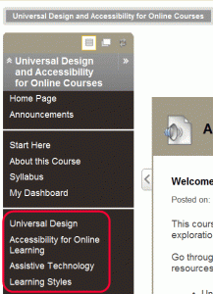
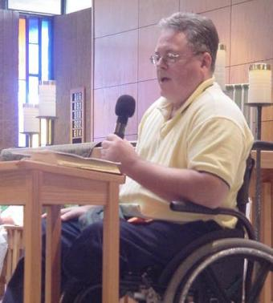
Designing Messages and Materials for Accessibility
A growing concern
Primary focus: Blind or partially sighted individuals
Also mobility impaired, deaf, learning disabled, dyslexic, etc.
Ed materials online have been a special focus

Slide 12
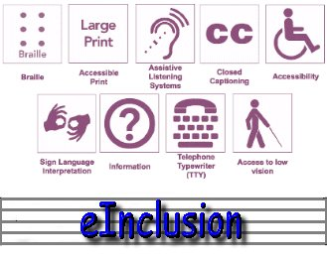
Designing for e-Inclusion
When you illustrate, whose pictures do you show?
Gender, age, ethnicity, ability, LGBT, etc.
“e-Inclusion” as a design principle
Used more in Europe to date

Slide 13
Web Sites and e-Communication
Evolving discipline, with rapid changes in basic patterns
Increasing turn to HCI (Human-Computer Interaction) literature and procedures
“User-based design”

Slide 14
Future of Web Design
From today’s ACM TechNews:
“Interactive 3D graphical objects may soon be common on the web”

Slide 15
Learning Materials and iBook Author
Apple’s new iBooks Author
Templates, Widgets
Visual index
Embeddable video, animations
Study cards, glossary
Quizzes, review questions
But… lack of sharing features
Controversy over “exclusivity” (now rescinded)
Proprietary…

Slide 16
Alternatives to Apple

Slide 17
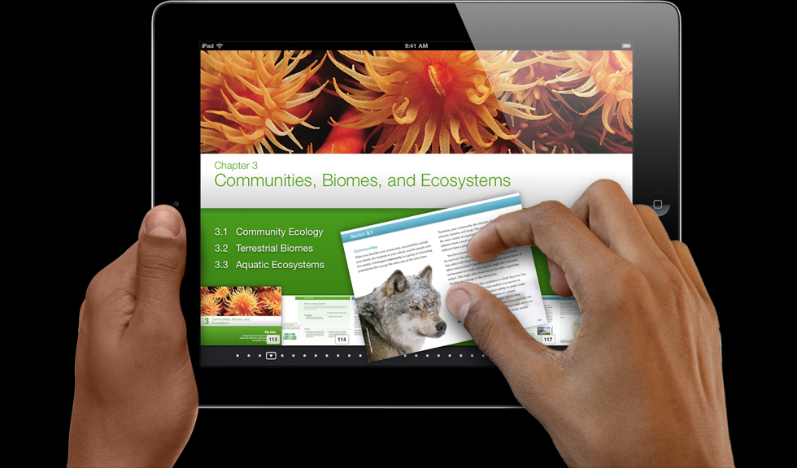
Becoming an iAuthor
Becoming proficient in using these new tools will take some time for teachers, faculty
iBooks could foster collaborative learning
Students could work with faculty, teachers to co-create these materials
How much time are educators willing to spend?

Slide 18
“Coding our minds…”
“Technology codes our minds, changes our OS. … magazines are now useless and impossible to understand, for digital natives. … Humble tribute to Steve Jobs, by the most important person : a baby”.
A Magazine Is an iPad That Does Not Work

Slide 19
Who Designs?
With widespread use of authoring tools and crowd sourcing, do we need professional authors anymore?
What did the old system get us?
What might we get with a different system?

Slide 20
Past Experience
Textbooks = a corporate product
Increasingly so with web addenda, consumables, etc.
Value: lots of cross-checking and accountability
Problem: Very slow, cumbersome, expensive

Slide 21
Games!
Lots of interest in student-designed games
Generates much enthusiasm and motivation
But: Resource base is very different, results often seem amateurish
Student comment: “Don’t try to use our technology; you’ll only look stupid.”
Scratch at MIT

Slide 22
The Un-encountered Curriculum
What could (should?) we have considered here that we haven’t?
Discuss!

Slide 23
What Could We Have Considered?
Ads and persuasive messages – their impact and educational role (e.g., political messages)
Auto-generated messages
Rise of voice recognition systems -- Robotics and CHI
Initiatives in other countries (e.g., JISC in UK)
Non-instructional but educative messages
designed aspects of the physical environment (e.g., Princess Diana Memorial Fountain)
Virtual and immersive reality

Slide 24
Next…
Project check-in
Designing our final class session; suggestion:
Very brief shout-outs (“I did such and such…”)
Brief mill-about – Questions or comments to people who did stuff you’re curious about
Small group discussion; questions:
What parts of your project were especially difficult, and why?
What did you find that you didn’t expect to find?
What did you not find that you thought you would? (And why do you think that was so?)
What did you learn?

Slide 25
Thanks!
See you next week for our final session

